Slide 1
SPRING CRUD CLINIC
Adithya K Prabhu
Sunitha VS
Najma E
Jyothika
Pooja R

Slide 2
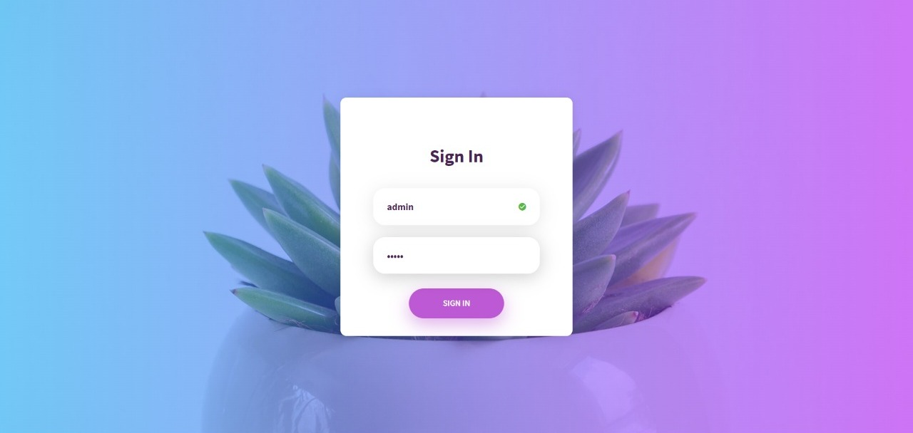
SIGN IN PAGE

Slide 3
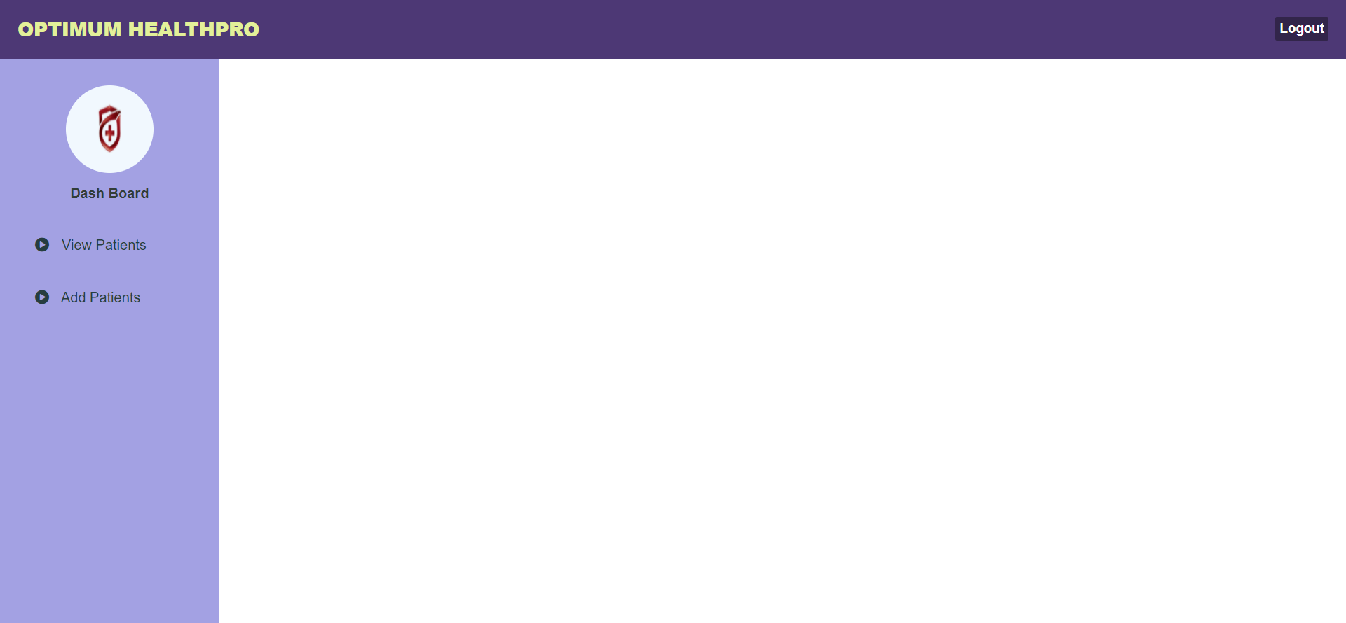
DASH BOARD

Slide 4
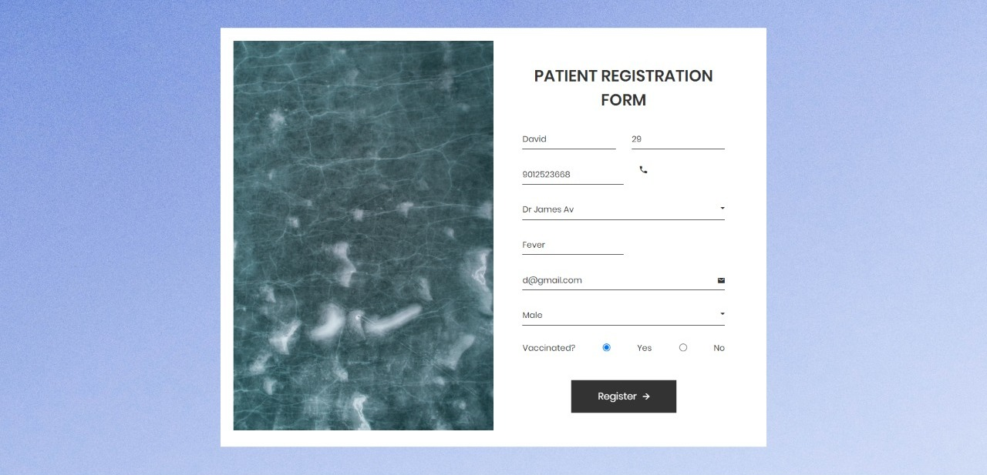
REGISTRATION FORM

Slide 5
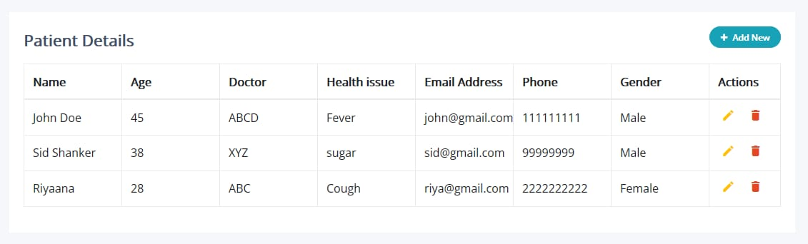
VIEW, UPDATE, DELETE
ADD

Slide 6
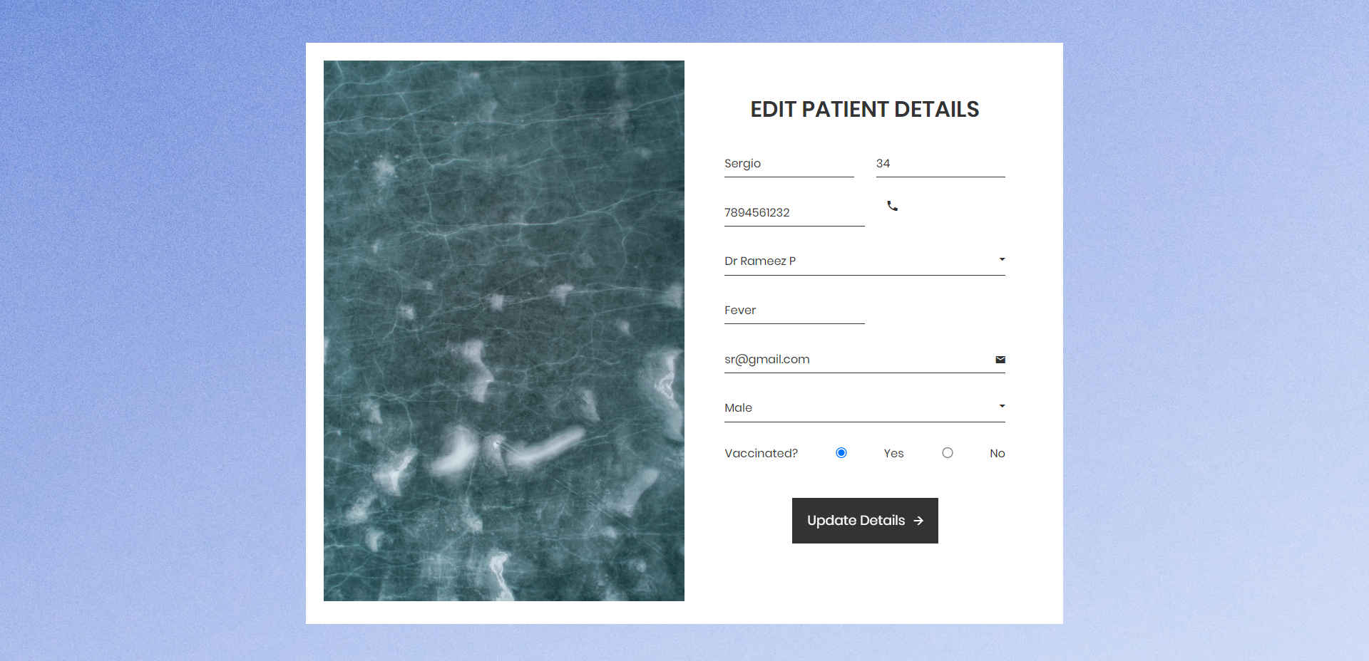
Edit Patient Details

Slide 7
LOGIN
User_name | Varchar(20), Primary key
Password | Varchar(20)
PATIENT
P_id | Int , Primary key,Auto
Name | Char(25)
Age | Int
Doctor | Char(25)
Health Issue | Char(25)
Email | Varchar(25)
Phone | Int
Gender | Char(20)
Patient Table

Slide 8


